Slide 1
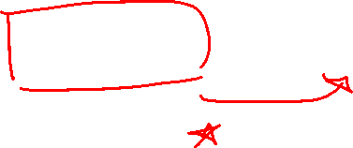
Chapter 2 Limits and Derivatives
Introduction

Slide 2
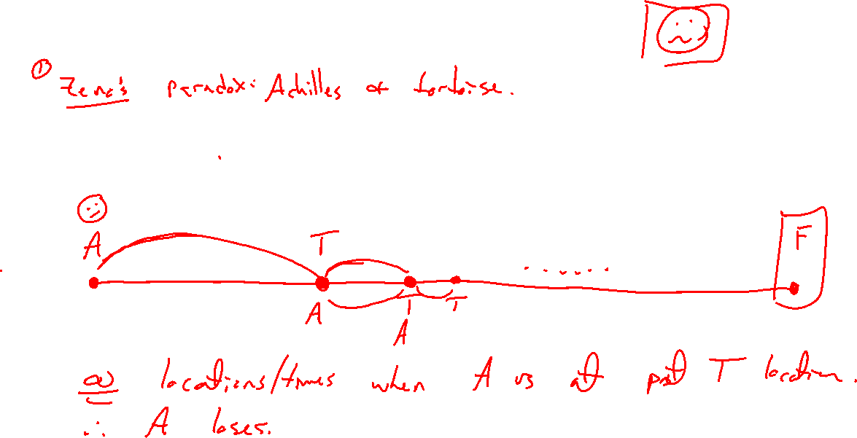
Paradoxes and the need for rigor
Notes:
Zeno paradox (Achilles and tortoise) https://en.wikipedia.org/wiki/Zeno%27s_paradoxes
1=0.999999 https://en.wikipedia.org/wiki/0.999...
D= rt (inst veloc), newton quote https://en.wikipedia.org/wiki/History_of_calculus
Achimedes: Practical solutions to be had: https://en.wikipedia.org/wiki/The_Quadrature_of_the_Parabola
Used and criticised thru history, idea of limit formalized in 19th century, let to revolution in mathematical analysis

Slide 3
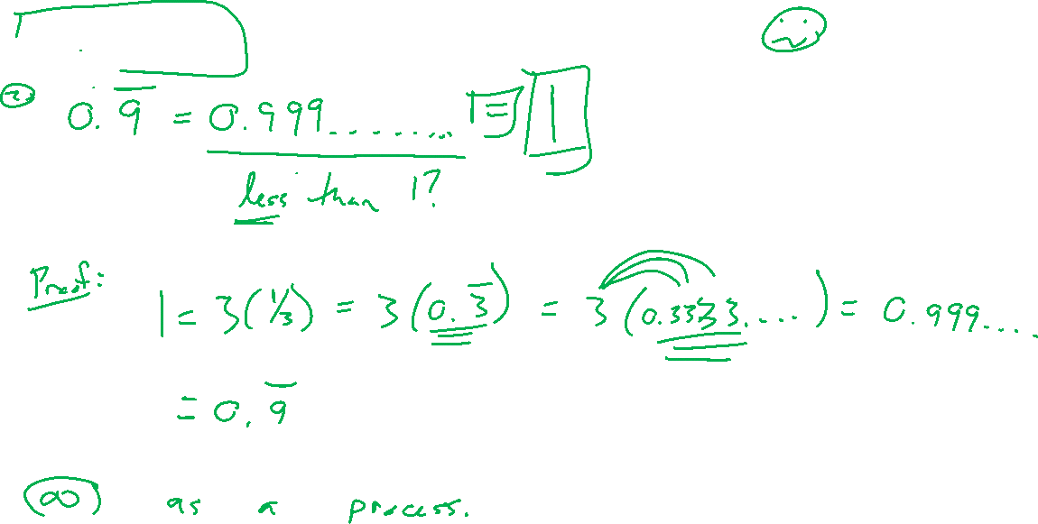
Paradoxes and the need for rigor
Notes:
Zeno paradox (Achilles and tortoise) https://en.wikipedia.org/wiki/Zeno%27s_paradoxes
1=0.999999 https://en.wikipedia.org/wiki/0.999...
D= rt (inst veloc), newton quote https://en.wikipedia.org/wiki/History_of_calculus
Achimedes: Practical solutions to be had: https://en.wikipedia.org/wiki/The_Quadrature_of_the_Parabola
Used and criticised thru history, idea of limit formalized in 19th century, let to revolution in mathematical analysis

Slide 4
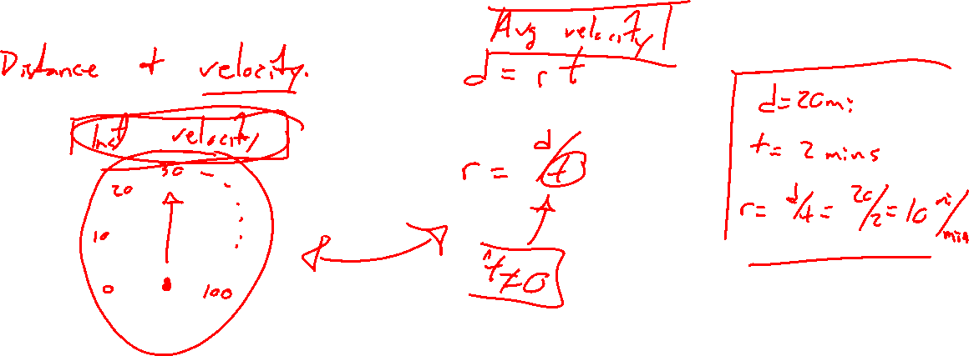
Paradoxes and the need for rigor
Notes:
Zeno paradox (Achilles and tortoise) https://en.wikipedia.org/wiki/Zeno%27s_paradoxes
1=0.999999 https://en.wikipedia.org/wiki/0.999...
D= rt (inst veloc), newton quote https://en.wikipedia.org/wiki/History_of_calculus
Achimedes: Practical solutions to be had: https://en.wikipedia.org/wiki/The_Quadrature_of_the_Parabola
Used and criticised thru history, idea of limit formalized in 19th century, let to revolution in mathematical analysis

Slide 5
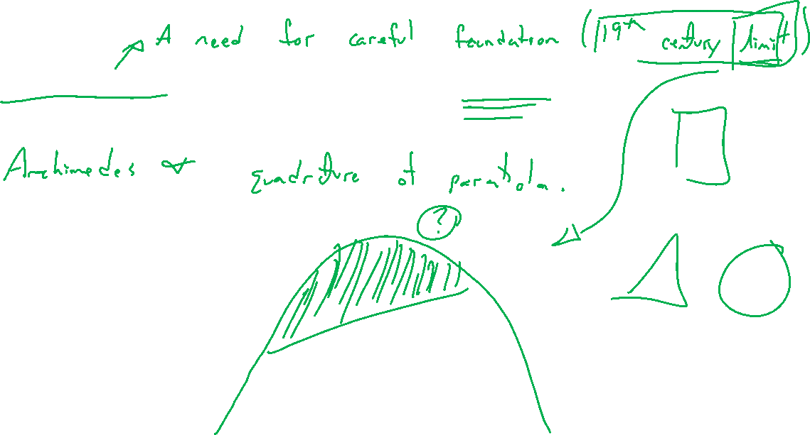
Paradoxes and the need for rigor
Notes:
Zeno paradox (Achilles and tortoise) https://en.wikipedia.org/wiki/Zeno%27s_paradoxes
1=0.999999 https://en.wikipedia.org/wiki/0.999...
D= rt (inst veloc), newton quote https://en.wikipedia.org/wiki/History_of_calculus
Achimedes: Practical solutions to be had: https://en.wikipedia.org/wiki/The_Quadrature_of_the_Parabola
Used and criticised thru history, idea of limit formalized in 19th century, let to revolution in mathematical analysis

Slide 6
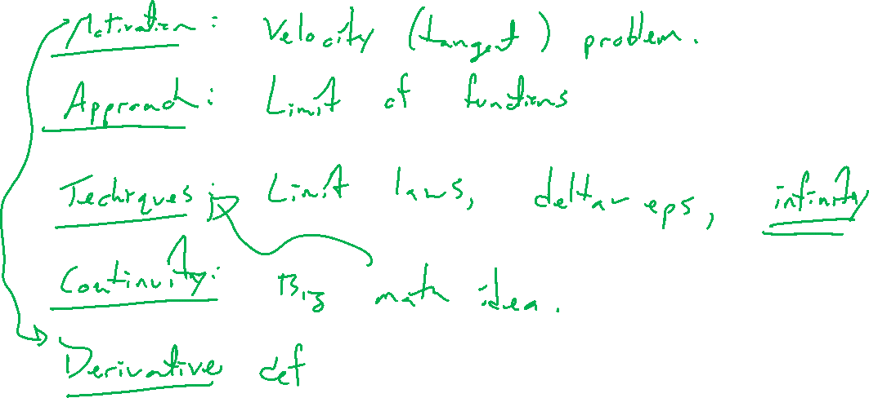
Outline of Chapter
Notes:
Motivation: Tangent / velocity problem
Approach: Limit of a function
Techniques: Limit laws, delta eps, infinity
Continuity: Big math idea
Derivative definition

